Slide 1
Workflows in Galaxy
Exercise II: Modify and run a workflow in Galaxy
Taxonomic profiling of metagenomic sample
Erik Hjerde

Slide 2
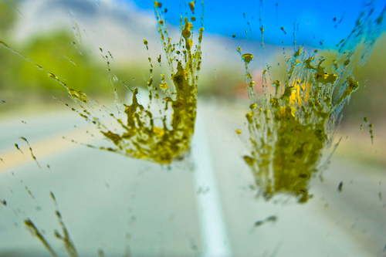
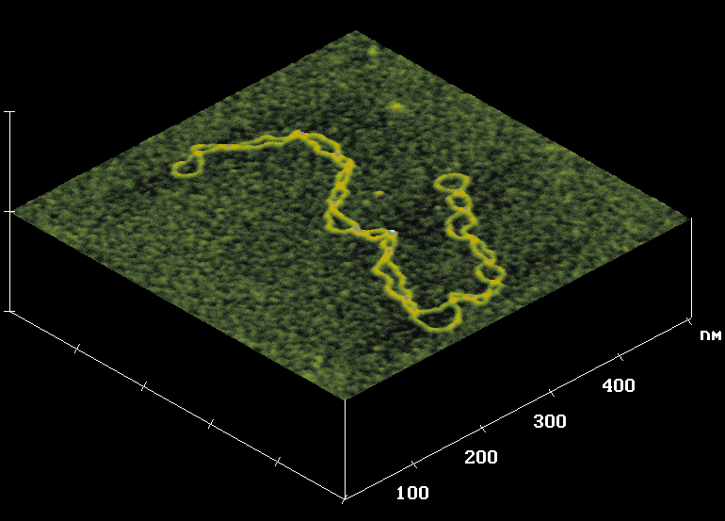
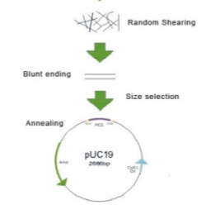
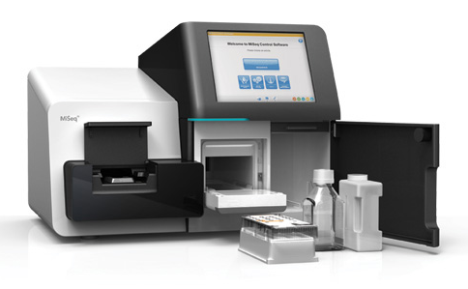
Metagenomics
The study of genetic material directly from a sample
Direct isolation of gDNA
Sequencing library
Sequencing

Slide 3


Metagenomics
YESS!!
Jeg har data.
Hva nå???
Mariam Quiñones

Slide 4
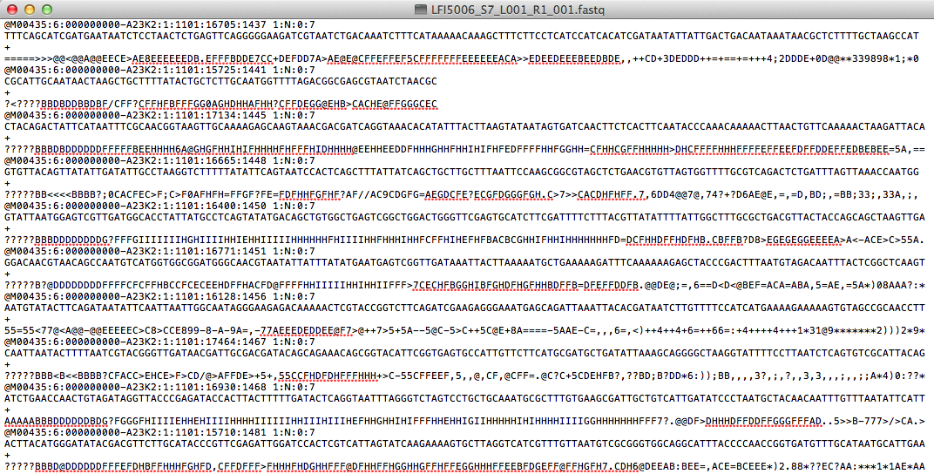
Metagenomics
The study of genetic material directly from a sample
Direct isolation of gDNA
Sequencing library
Sequencing

Slide 5

How do we study the taxonomy in a sample?
Each sequence read is a tiny genomic fragment from a specie in the sample
In a metagenome a sequence read is basically representing a specie
AGTCCAGGTAACGTTACAACG

Slide 6

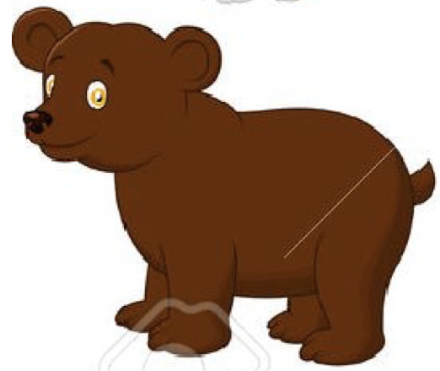

How do we study the taxonomy in a sample?
Each sequence read is a tiny genomic fragment from a specie in the sample
In a metagenome a sequence read is basically representing a specie
AGTCCAGGTAACGTTACAACG

Slide 7
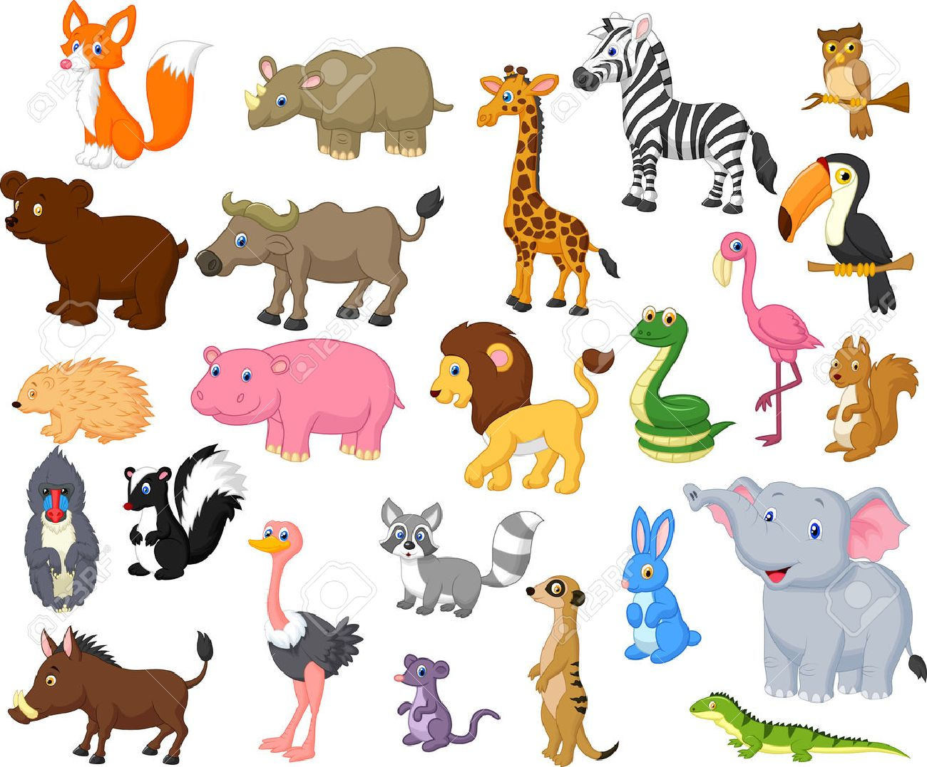



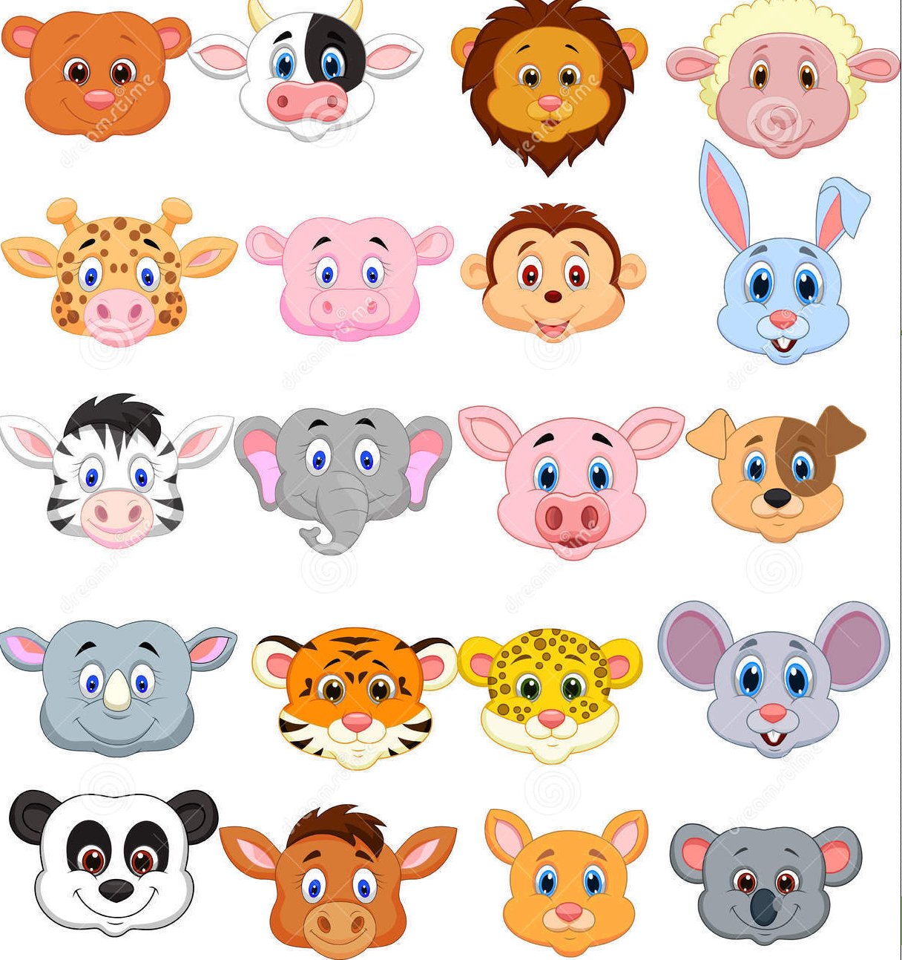

How do we study the taxonomy in a sample?
The sequence reads are compared to known sequences in databases
Database
Sample
Compare

Slide 8



How do we study the taxonomy in a sample?
By comparing all the sequences in the sample and counting the occurrences, we can generate a taxonomic profile of the sample
Unknown
Prøve | 4 | 2 | 5 | 5 | 6 |  | 2

Slide 9
Exercise II
TASK:
Modify a workflow
Import data from NeLS
Run analysis on proper data using the workflow

Slide 10
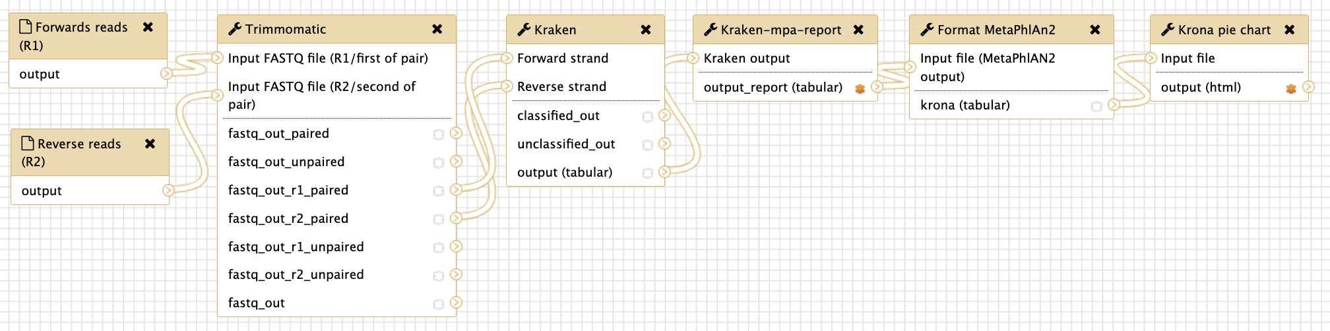
The existing workflow

Slide 11
The existing workflow
Define input data

Slide 12
The existing workflow
Filter poor quality data

Slide 13
The existing workflow
Taxonomic assignment of sequence reads

Slide 14
The existing workflow
Reformat file

Slide 15
The existing workflow
Reformat file (again)

Slide 16
The existing workflow
Generate visualisation

Slide 17
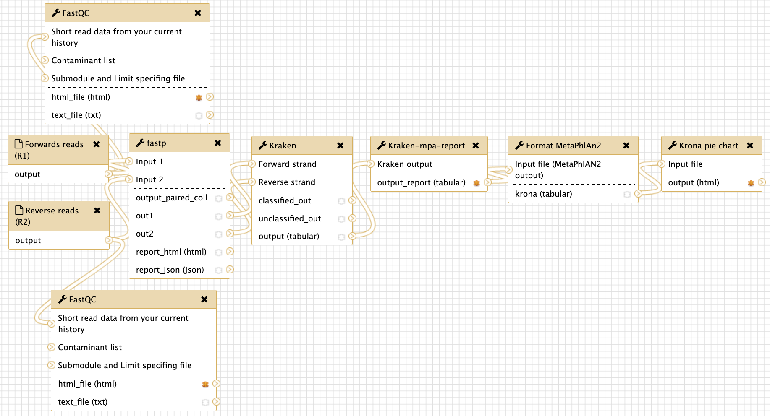
The final workflow

